Slide 1
SQLite and Applications
오기환
(wurikiji@gmail.com)
SKKU VLDB Lab. (27334)

Slide 2
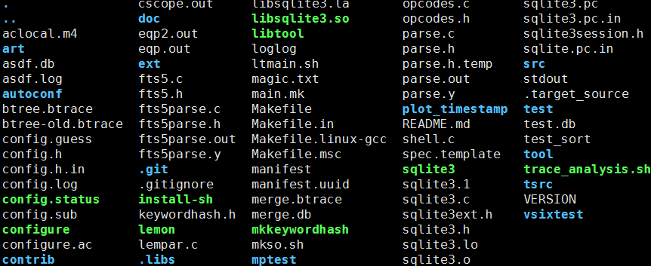
SQLite3
SQLite3 is a library not an application
“sqlite3” binary file, which is created by ‘make’ command, is an sample application
Real sqlite3 is ‘libsqlite3.so’ in “.libs” folder

Slide 3
shell.c
‘shell.c’ is a sample application to create ‘sqlite3’ binary file
Modification of this file does not affect to ‘pytpcc’

Slide 4
sqlite3.h & sqlite3ext.h
Define or add new functions and global variables here
In order to use them in sqlite3 applications including ‘sqlite3’ and ‘pytpcc’
“.help”-like ‘dot commands’ are not SQL statement supported by SQLite3
These are only supported by ‘sqlite3’ binary which is implemented by ‘shell.c’

Slide 5
python-tpcc
Add execution time options to ‘tpcc.py’
In order to use new options when executing ‘python tpcc.py’
I already added ‘--journal’ and ‘--buffer’ options
Add parser for new options to ‘drivers/sqlitedriver.py’
Into ‘def loadConfig(self, config):’ function
I already added parer for ‘--journal’ and ‘--buffer’

